Slide 1

Computer Engineering Department
System 2 AI poster presentation
Language Diffusion Models
By:
Farzan Rahmani
Alireza Faraj Tabrizi

Slide 2
Table of contents
Preliminary works
Diffusion Guided Language Modeling
Large Language Diffusion Models
LLaDA-V: Large Language Diffusion Models with Visual Instruction Tuning
LLaDA 1.5: Variance-Reduced Preference Optimization for Large Language Diffusion Models
References

Slide 3
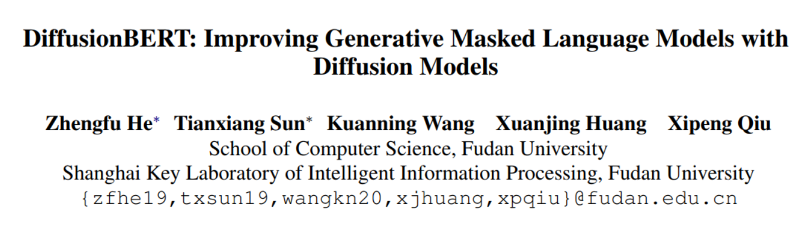
Preliminary works
Li et al. (2022): “DiffusionBERT: Improving Generative Masked Language Models with Diffusion Models” - Establishes early connections between diffusion processes and masked language modeling.

Slide 4
Challenges
Continuous Noise and Space vs Discrete Space of Text.
What is a good Denoiser here?
Slow Convergence and No use of Transfer Learning.
Handling Time Information.

Slide 5
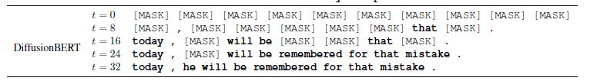
Noise Handling

Slide 6
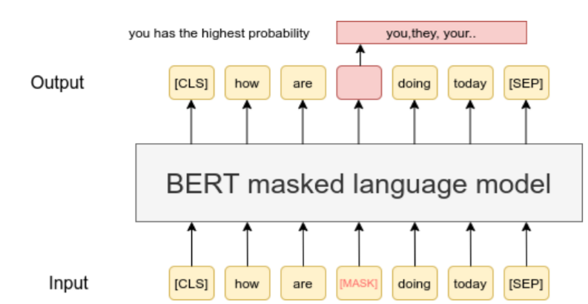
BERT

Slide 7
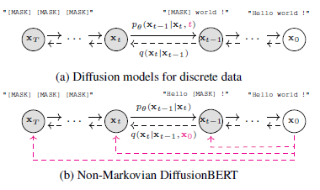
DiffusionBERT: Improving Generative Masked Language Models with Diffusion Models

Slide 8
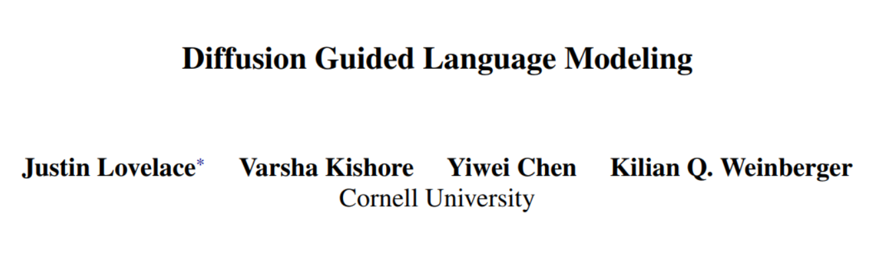
Diffusion Guided Language Modeling
This paper provides foundational insights into integrating diffusion principles with language modeling, offering novel training techniques and evaluation frameworks for diffusion-based text generation.

Slide 9
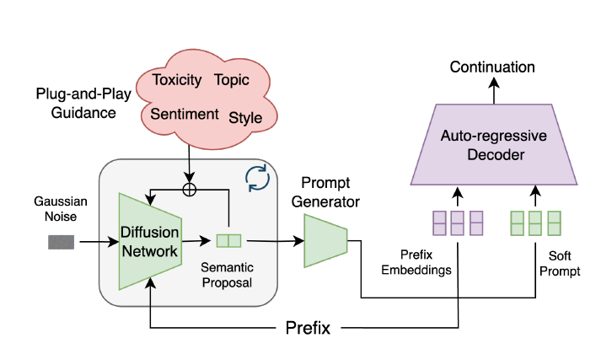
Diffusion Guided Language Modeling

Slide 10
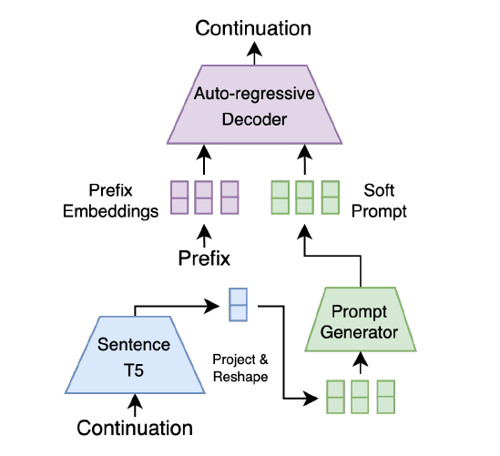
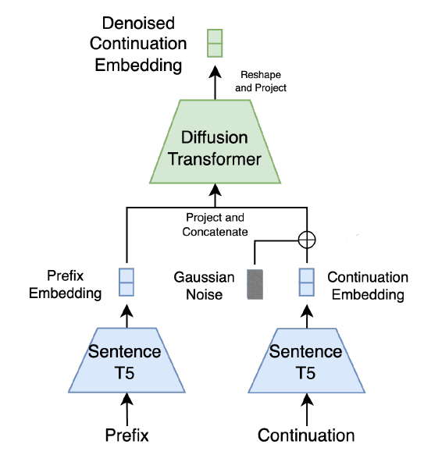
Diffusion Guided Language Modeling

Slide 11

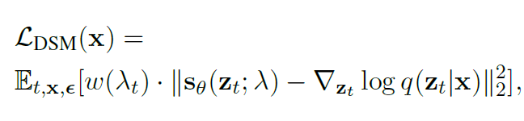
Diffusion Background (Unconditional)

Slide 12
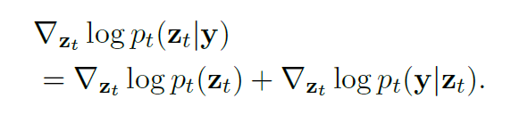

Diffusion Background (Conditional)

Slide 13
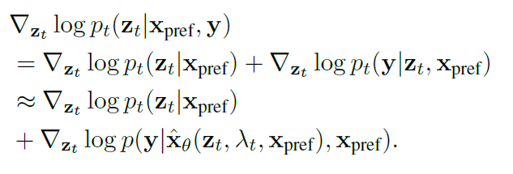
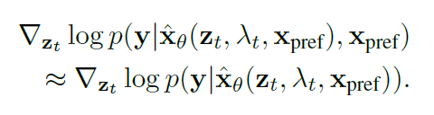
Diffusion Guided Language Modeling

Slide 14
Metrics
Perplexity (Fluency)
MAUVE (Distribution Comparison)
DIV (Text Generation Diversity)
Perspective API and RoBERTa Large (Adherence to guidance conditions)

Slide 15
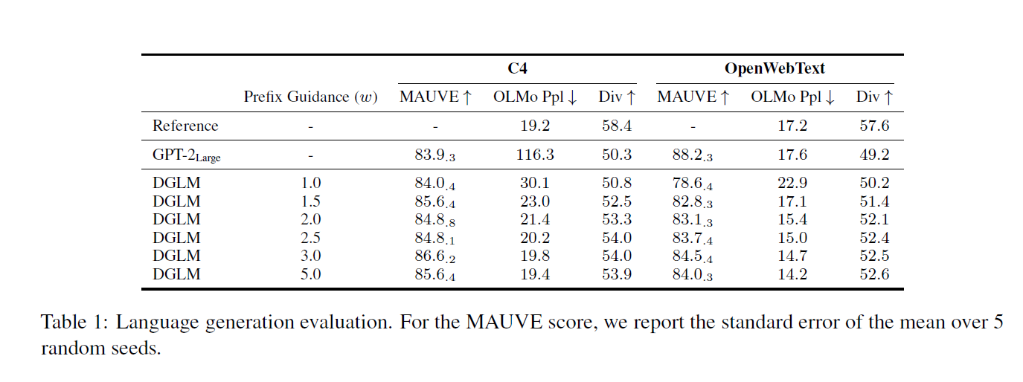
Results

Slide 16
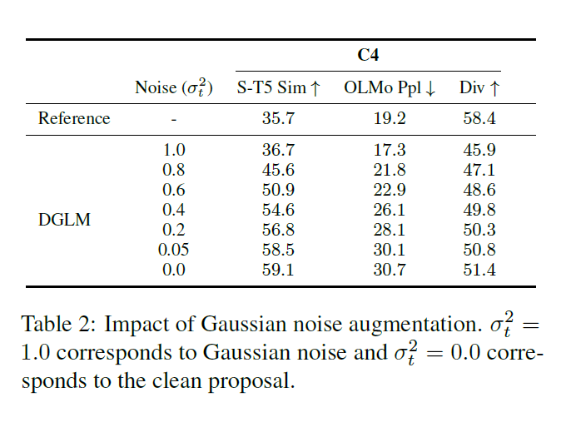
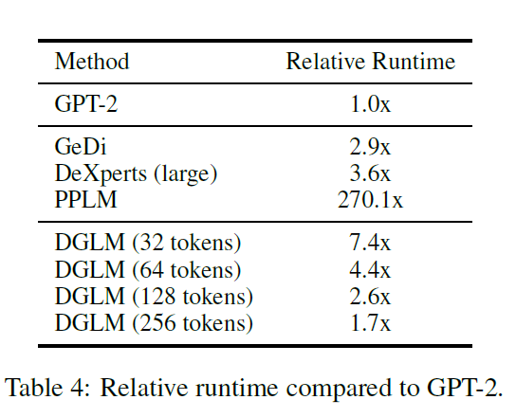
Results

Slide 17
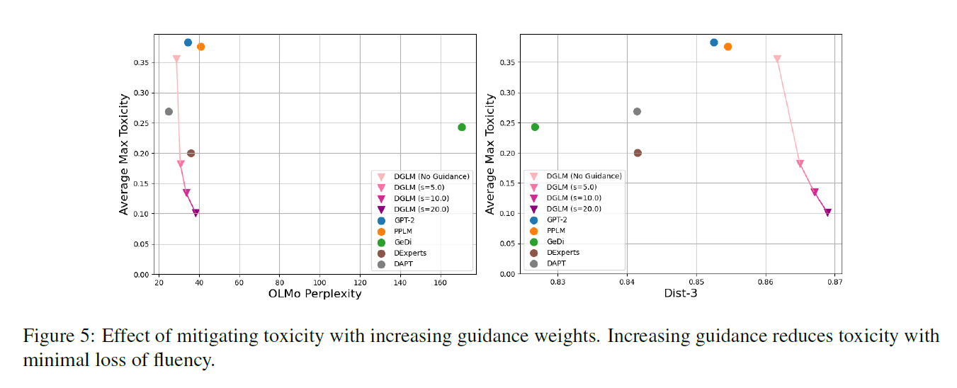
Results

Slide 18
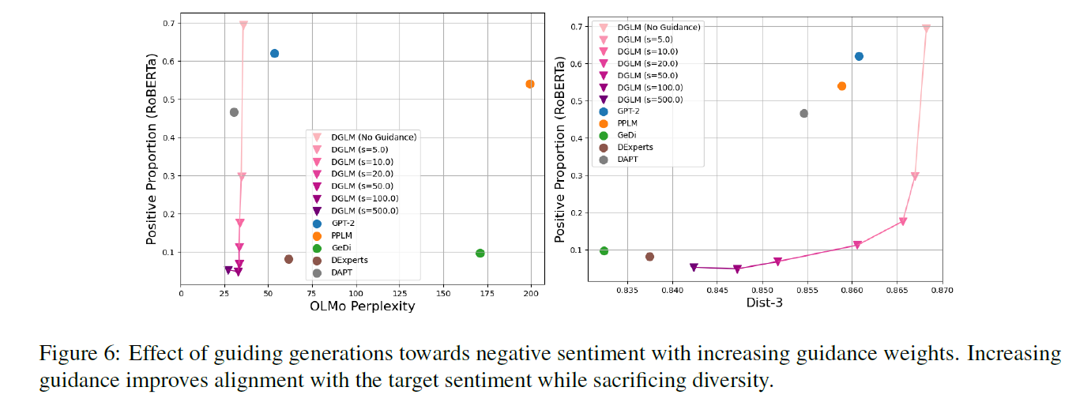
Results

Slide 19
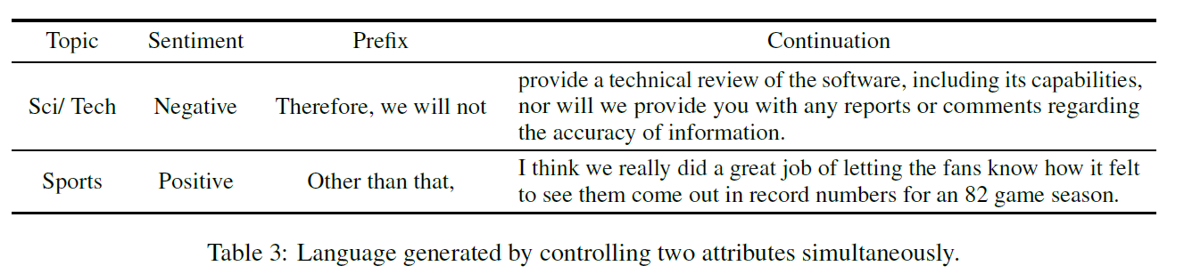
Results

Slide 20
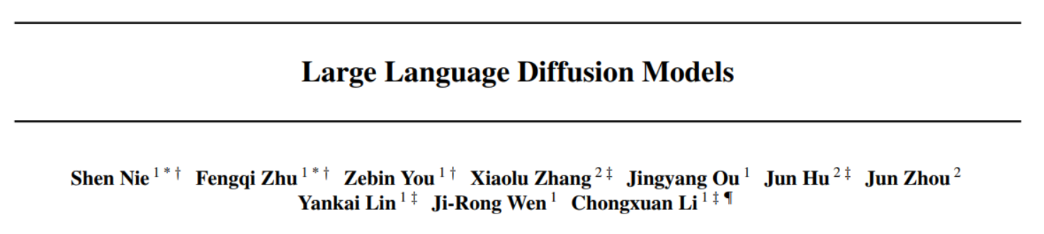
Large Language Diffusion Models
This groundbreaking work introduces LLaDA, the first large-scale language diffusion model trained entirely from scratch, demonstrating that diffusion approaches can scale to billions of parameters while maintaining competitive performance with leading autoregressive models.

Slide 21
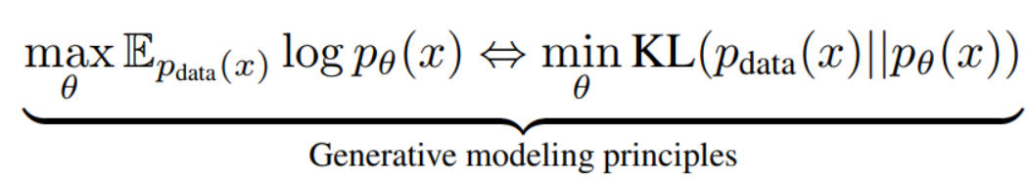
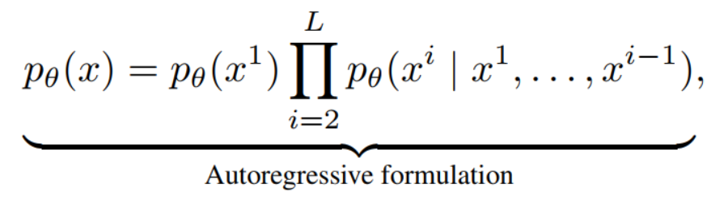
Large language models (LLMs) in the framework of generative modeling
unknown language distribution
maximum likelihood estimation
autoregressive modeling (ARM)
Notes:
capture unknown language distribution by optimizing a model distribution
through maximum likelihood estimation, or equivalently KL divergence minimization between the two distributions:
The predominant approach relies on the autoregressive modeling (ARM) commonly referred to as the next-token prediction paradigm:

Slide 22
Is the AR paradigm the only viable path to achieving the intelligence exhibited by LLMs?
answer is not a simple “yes”
generative modeling principles, rather than the autoregressive formulation itself
essential properties from generative modeling
limitations of LLMs from autoregressive nature
scalability: interplay between Transformers, model and data size induced by the generative principles
instruction-following and in-context learning: all proper conditional generative models
AR nature of LLMs challenges: high computational costs, reversal reasoning tasks.
Notes:
answer is not a simple “yes”
it is the generative modeling principles, rather than the autoregressive formulation itself
generative modeling fundamentally underpin the essential properties of LLMs
certain inherent limitations of LLMs can be directly traced to their autoregressive nature.
scalability is primarily a consequence of the interplay between Transformers, model and data size induced by the generative principles, rather than a unique result of ARM. (success of diffusion on visual data )
capabilities of instruction-following and in-context learning appear to be intrinsic properties of all proper conditional generative models on structurally consistent linguistic tasks, rather than exclusive advantages of ARMs.
the autoregressive nature of LLMs presents notable challenges. For example, high computational costs, reversal reasoning tasks. These inherent limitations constrain LLMs in handling longer and more complex tasks.

Slide 23
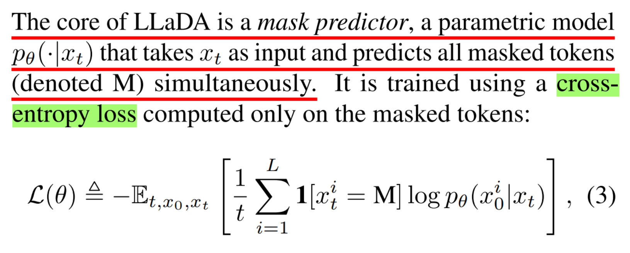
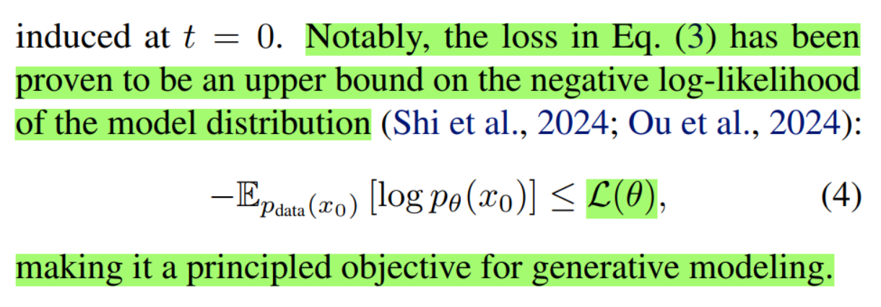
LLaDA, a Large Language Diffusion with mAsking
capabilities of LLMs can emerge from generative modeling principles
LLaDA leverages a MDM
a discrete random masking process and a mask predictor to approximate its reverse process
bidirectional dependencies
optimize a lower bound of its log-likelihood
Notes:
to investigate whether the capabilities exhibited by LLMs can emerge from generative modeling principles beyond ARMs
LLaDA leverages a masked diffusion model (MDM)
incorporates a discrete random masking process and trains a mask predictor to approximate its reverse process
construct a model

Slide 24
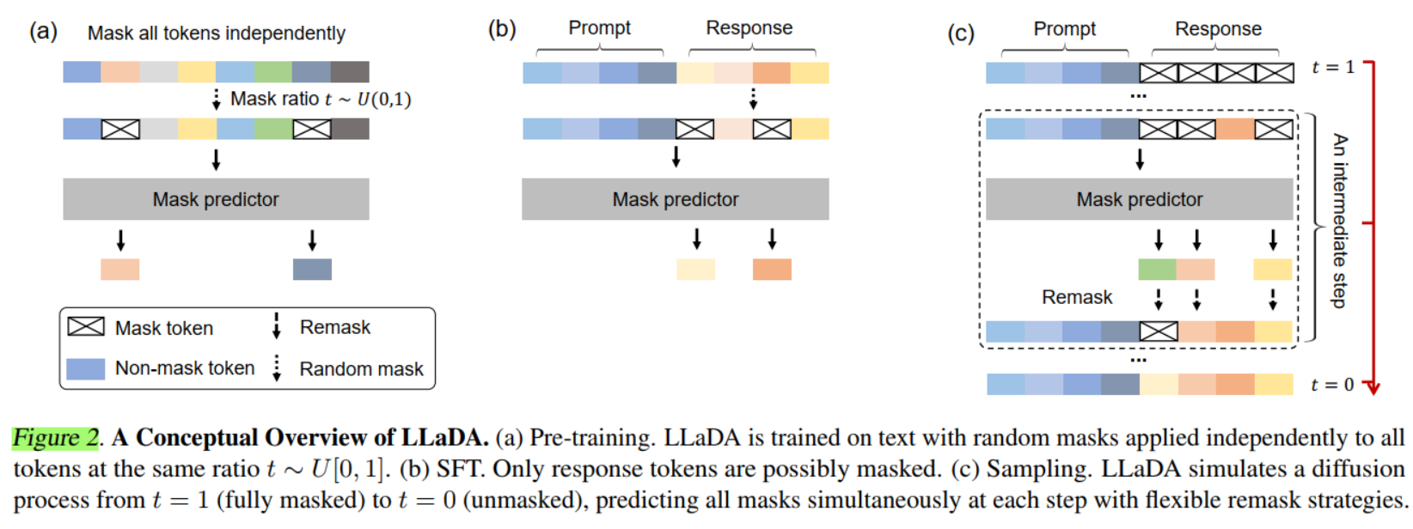
LLaDA, a Large Language Diffusion with mAsking (continued)
adopt the standard pipeline, scaling LLaDA to an unprecedented language diffusion of size 8B.
Notes:
adopt the standard pipeline of data preparation, pretraining, supervised fine-tuning (SFT), and evaluation, scaling LLaDA to an unprecedented language diffusion of size 8B.

Slide 25
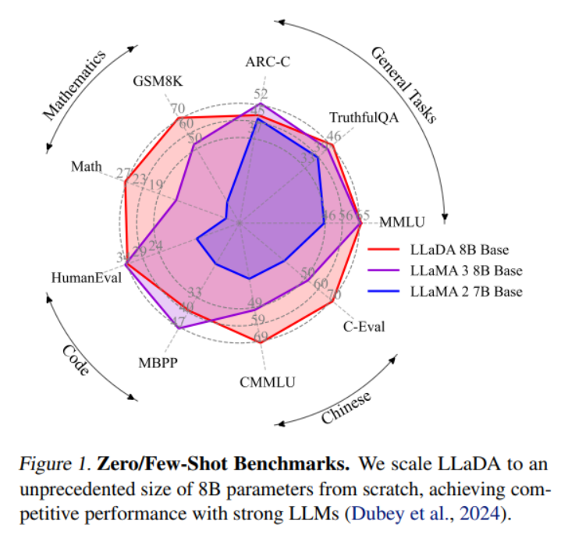
masked diffusion model is comparable with ARMs

Slide 26
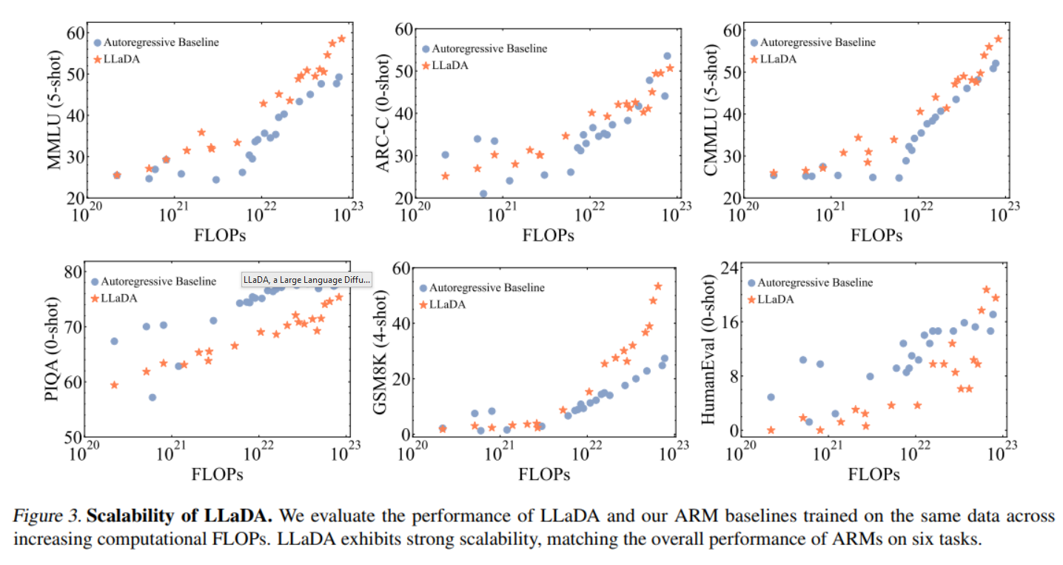
Contributions of the LLaDA
Scalability. LLaDA scales effectively.
In-Context Learning. Remarkably, LLaDA 8B surpasses LLaMA2 7B.
Notes:
Scalability. LLaDA scales effectively, achieving comparable results to ARM baselines trained on the same data across six tasks, e.g., MMLU and GSM8K.
In-Context Learning. Remarkably, LLaDA 8B surpasses LLaMA2 7B on nearly all 15 standard zero/few-shot learning tasks while performing on par with LLaMA3.

Slide 27

Contributions of the LLaDA
Instruction-Following. LLaDA significantly enhances the ability to follow instructions after SFT.
Notes:
Instruction-Following. LLaDA significantly enhances the ability to follow instructions after SFT such as multi-turn dialogue.

Slide 28
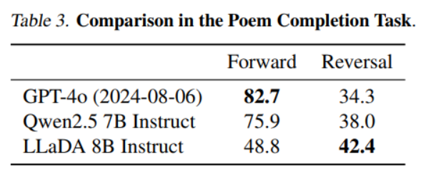
Contributions of the LLaDA
Reversal Reasoning. LLaDA breaks the reversal curse. Notably, it outperforms GPT-4o.
not have left-to-right bias but balanced performance.
both Qwen 2.5 and GPT-4o exhibit a significant gap between the two.
Notes:
Reversal Reasoning. LLaDA effectively breaks the reversal with consistent performance across forward and reversal tasks. Notably, it outperforms GPT-4o in a reversal poem completion task.
It does not have left-to-right bias but balanced performance.
both Qwen 2.5 and GPT-4o exhibit a significant gap between the two. The results on forward generation confirm that both ARMs are strong, benefiting from significantly larger datasets and greater computational resources than LLaDA.

Slide 29
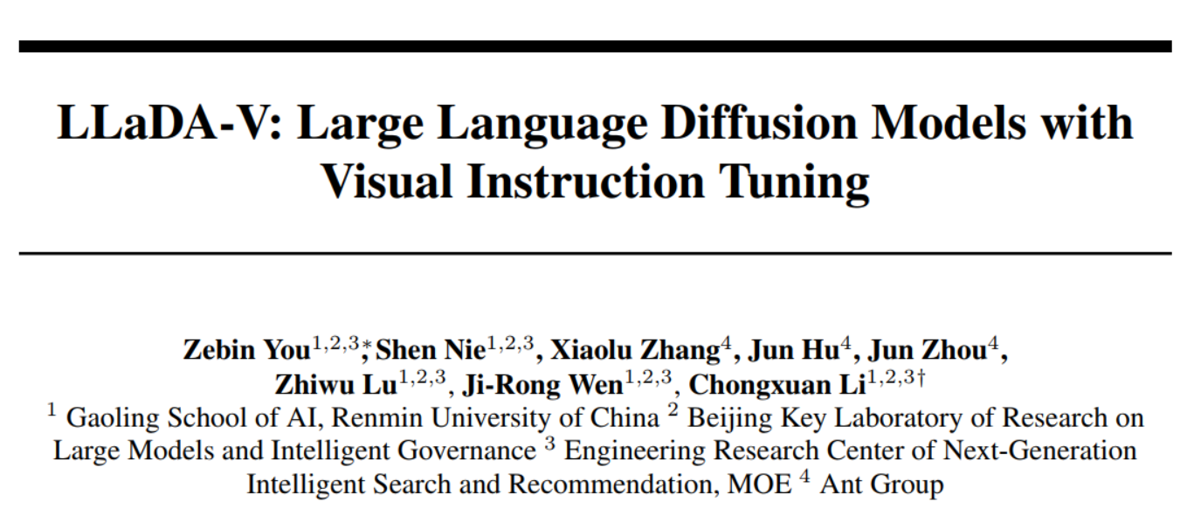
LLaDA-V: Large Language Diffusion Models with Visual Instruction Tuning
Extends language diffusion models to multimodal settings, incorporating visual understanding capabilities and demonstrating how diffusion approaches can be adapted for vision-language tasks with instruction following.

Slide 30
Can a purely diffuision based MLLM achieve performance compared to ARMs?
MLLMs are capable of processing multiple input modalities
most existing approaches predominantly rely on ARMs.
LLaDA’s capabilities and potential in multimodal understanding remain largely unexplored.
how to effectively extend large language diffusion models to encompass strong multimodal understanding capabilities.
Notes:
** visual instruction tuning framework has demonstrated remarkable effectiveness across various autoregressive-based MLLMs
MLLMs are capable of processing multiple input modalities—including image, audio, and video—alongside text
most existing approaches predominantly rely on ARMs, leaving substantial room for exploring alternative probabilistic modeling approaches such as diffusion.
while LLaDA has shown remarkable progress in language modeling, its capabilities and potential in multimodal understanding remain largely unexplored.
This paper explores how to effectively extend large language diffusion models to encompass strong multimodal understanding capabilities, focusing on the visual instruction tuning framework.

Slide 31
How make LLaDA multimodal?
introduce a vision encoder and an MLP connector to map visual features into the LLaDA language embedding space.
extend LLaDA’s training objective
investigate various attention mechanism structures
adapt inference procedures for multimodal conversations
develop a multi-stage training strategy.
LLaDA-V, a purely diffusion-based MLLM.
It achieves SOTA results among both hybrid and purely diffusion-based MLLMs.
Notes:
introduce a vision encoder (e.g., SigLIP 2) and an MLP connector to map visual features into the LLaDA language embedding space, allowing joint processing of visual and textual inputs.
extend LLaDA’s training objective to handle multi-turn multimodal dialogues
investigate various attention mechanism structures
adapt inference procedures for multimodal conversations
develop a multi-stage training strategy.
These investigations result in LLaDA-V, a purely diffusion-based MLLM.
LLaDA-V achieves state-of-the-art results among both hybrid and purely diffusion-based MLLMs.

Slide 32
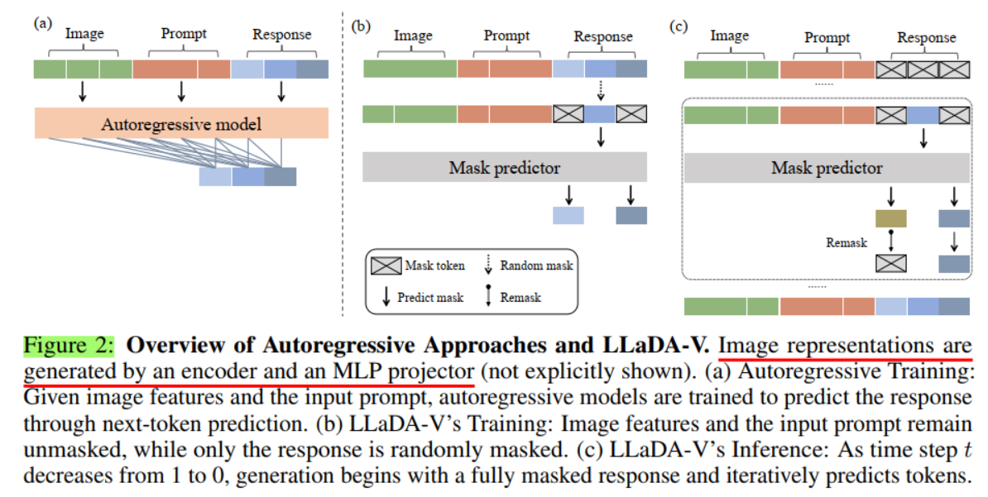
Autoregressive Approaches vs. LLaDA-V

Slide 33
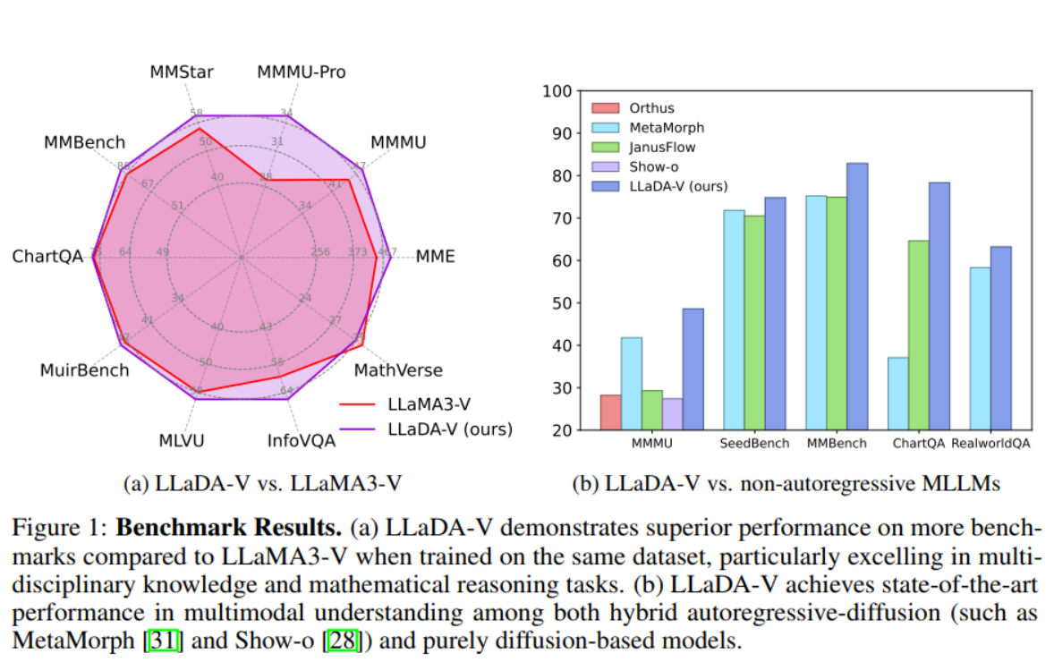
LLaDA-V Results
not only the effectiveness of the LLaDA-V framework but also the promise of diffusion models on multimodal understanding.
Notes:
These findings demonstrate not only the effectiveness of the LLaDA-V framework but also the promise of diffusion models on multimodal understanding.

Slide 34
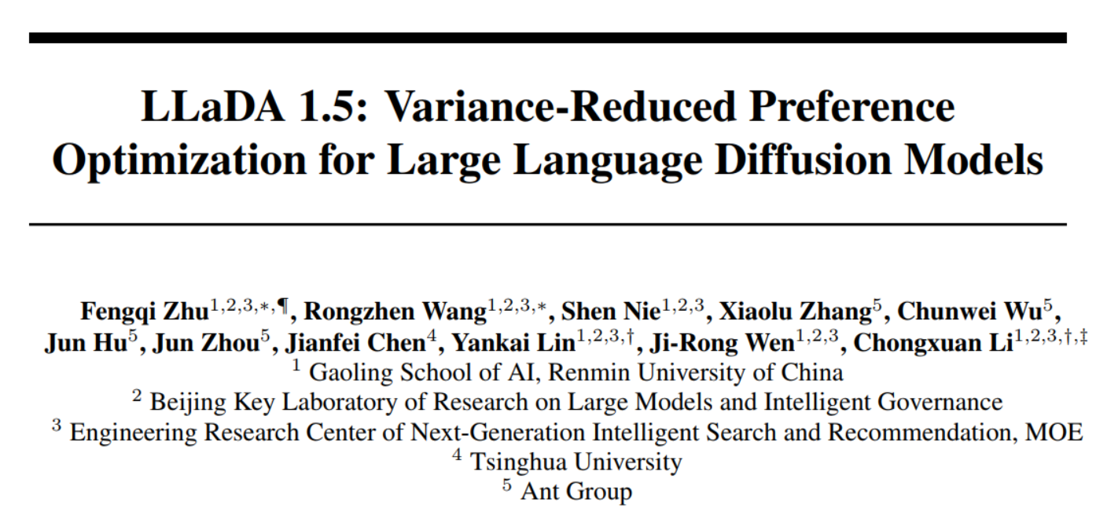
LLaDA 1.5: Variance-Reduced Preference Optimization for Large Language Diffusion Models
Introduces advanced optimization techniques specifically designed for language diffusion models, addressing training stability and preference alignment challenges through variance reduction methods.

Slide 35
LLaDA 1.5: Variance-Reduced Preference Optimization for Large Language Diffusion Models
By optimizing the ELBO or its variants, MDMs have demonstrated a comparable or even superior performance to ARMs at a small scale.
focused on unsupervised pretraining and supervised fine-tuning (SFT) paradigms
little effort in aligning these models with human preferences via RL
investigate the RL-based alignment of MDMs, focusing on the DPO algorithm
Previous estimation process introduces additional bias and variance
The introduced bias and variance are governed by the variance of the preference score estimator of ELBO.
Notes:
** A key challenge in applying DPO to MDMs lies in the intractability of the exact log-likelihoods required by the original DPO formulation. A natural solution is approximating these log-likelihoods by their ELBOs, which involve double expectations over the diffusion time and masked data. This substitution yields a preference score expressed as a linear combination of four ELBO terms.
By optimizing the evidence lower bound (ELBO) or its simplified variants, MDMs have demonstrated a comparable or even superior performance to ARMs at a small scale.
LLaDA has primarily focused on unsupervised pretraining and supervised fine-tuning (SFT) paradigms
There has been relatively little effort in aligning these models with human preferences via RL
This paper investigate the RL-based alignment of MDMs, focusing on the direct preference optimization (DPO) algorithm for its simplicity and strong empirical success.
Previous estimation process introduces additional bias and variance into the estimated loss and its gradient.
The introduced bias and variance are governed by the variance of the preference score estimator of ELBO.

Slide 36
LLaDA 1.5 introduce Variance-Reduced Policy Optimization (VRPO)
integrating principled techniques to reduce the variance of the estimator:
increasing the sampling budget for ELBOs
allocating sample budget across distinct diffusion timesteps
applying antithetic sampling between ELBO estimates of the model and reference policies
theoretically proven to reduce the variance of the preference score estimator in an unbiased manner
empirically validated in both synthetic and large-scale real-world ablation studies
Notes:
a method integrating principled techniques to reduce the variance of the preference score estimator:
increasing the sampling budget for ELBOs
allocating sample budget across distinct diffusion timesteps with one masked sample per timestep
applying antithetic sampling between ELBO estimates of the model and reference policies
theoretically proven to reduce the variance of the preference score estimator in an unbiased manner
empirically validated in both synthetic and large-scale real-world ablation studies

Slide 37
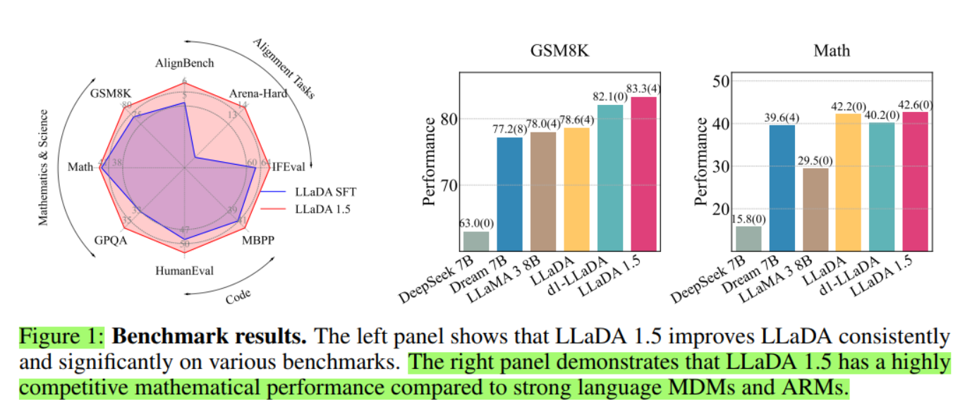
LLaDA 1.5 results

Slide 38
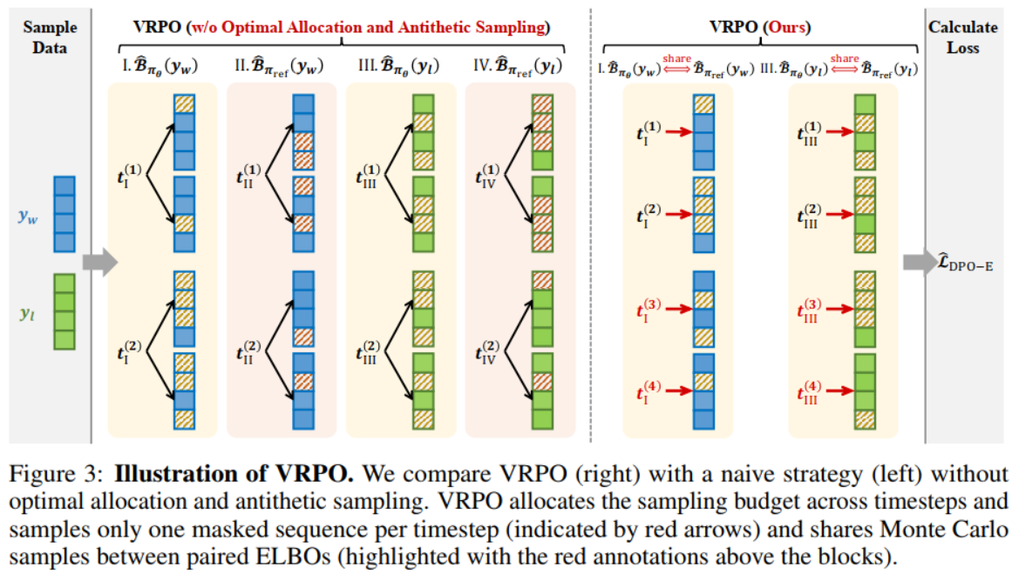
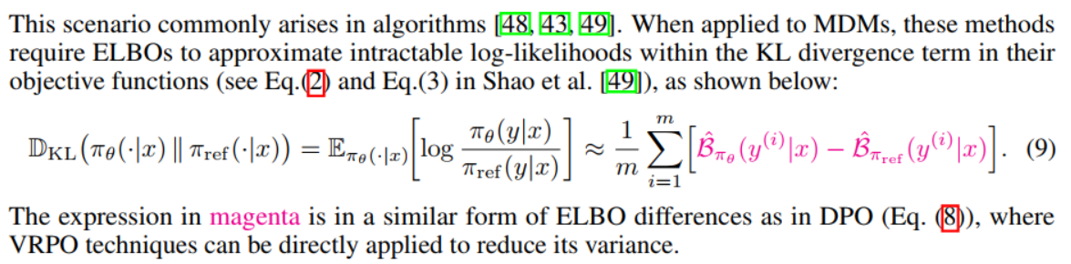
Variance-Reduced Policy Optimization (VRPO)

Slide 39
Refrences:
[1] S. Nie, Z. You, X. Zhang, J. Ou, Y. Lin, J. Wen, and C. Li, "Large Language Diffusion Models," (2025)
[2] J. Lovelace, V. Kishore, Y. Chen, and K. Q. Weinberger, "Diffusion Guided Language Modeling," in Findings of the Association for Computational Linguistics: ACL 2024, pp. 14936–14952, Association for Computational Linguistics, 2024
[3] Z. You, S. Nie, X. Zhang, J. Hu, J. Zhou, Z. Lu, J. Wen, and C. Li, "LLaDA-V: Large Language Diffusion Models with Visual Instruction Tuning," (2025)
[4] F. Zhu, R. Wang, S. Nie, and X. Zhang, "LLaDA 1.5: Variance-Reduced Preference Optimization for Large Language Diffusion Models," (2025)
[5] Z. He, T. Sun, K. Wang, X. Huang, and X. Qiu, "DiffusionBERT: Improving Generative Masked Language Models with Diffusion Models," in Proceedings of the 61st Annual Meeting of the Association for Computational Linguistics (Volume 1: Long Papers), Toronto, Canada, Jul. 2023, pp. 4521–4534

Slide 40
Thanks for your attention!

